Slide 1
Generations of Computers
Piragenth

Slide 2
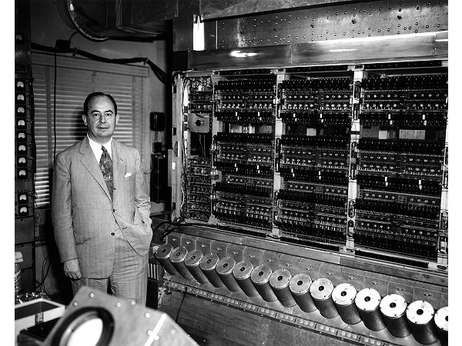
Introduction
The evolution of computers is often categorized into different generations, each marked by a significant technological breakthrough that revolutionized computing power, size, efficiency, and capabilities. These generations reflect the rapid advancements from the bulky, vacuum-tube-based machines of the 1940s to today’s intelligent, AI-powered systems. Understanding these generations not only helps us appreciate the progress in computing but also provides insight into how technology continues to shape our daily lives, industries, and future possibilities.

Slide 3
Generations
First Gen
Vacuum Tube
Second Gen
Transistor
Third Gen
Integrated Circuit
Fourth Gen
Very large integrated circuit
Ultra Large size integrated circuit
Fifth Gen

Slide 4
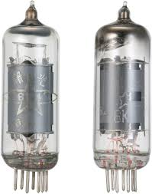
First Generation (1940s – 1956)
First-generation computers used vacuum tubes, making them large, slow, and prone to overheating. They relied on machine language and required huge amounts of power. These early machines, like the ENIAC and UNIVAC, were mostly used for scientific and military tasks.

Slide 5
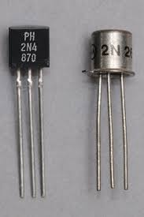
Second Generation (1956 – 1963)
The introduction of transistors made computers smaller, faster, and more reliable. Programming became easier with assembly language, and computers started to be used in businesses. Examples include the IBM 1401 and CDC 1604.

Slide 6
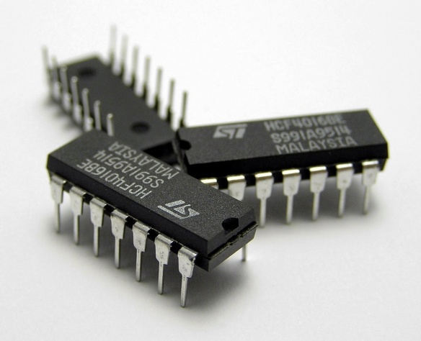
Third Generation (1964 – 1971)
Integrated circuits (ICs) replaced transistors, allowing even more compact and powerful machines. Computers began to support operating systems, monitors, and keyboards. Languages like FORTRAN and COBOL became standard. The IBM System/360 is a key example.

Slide 7
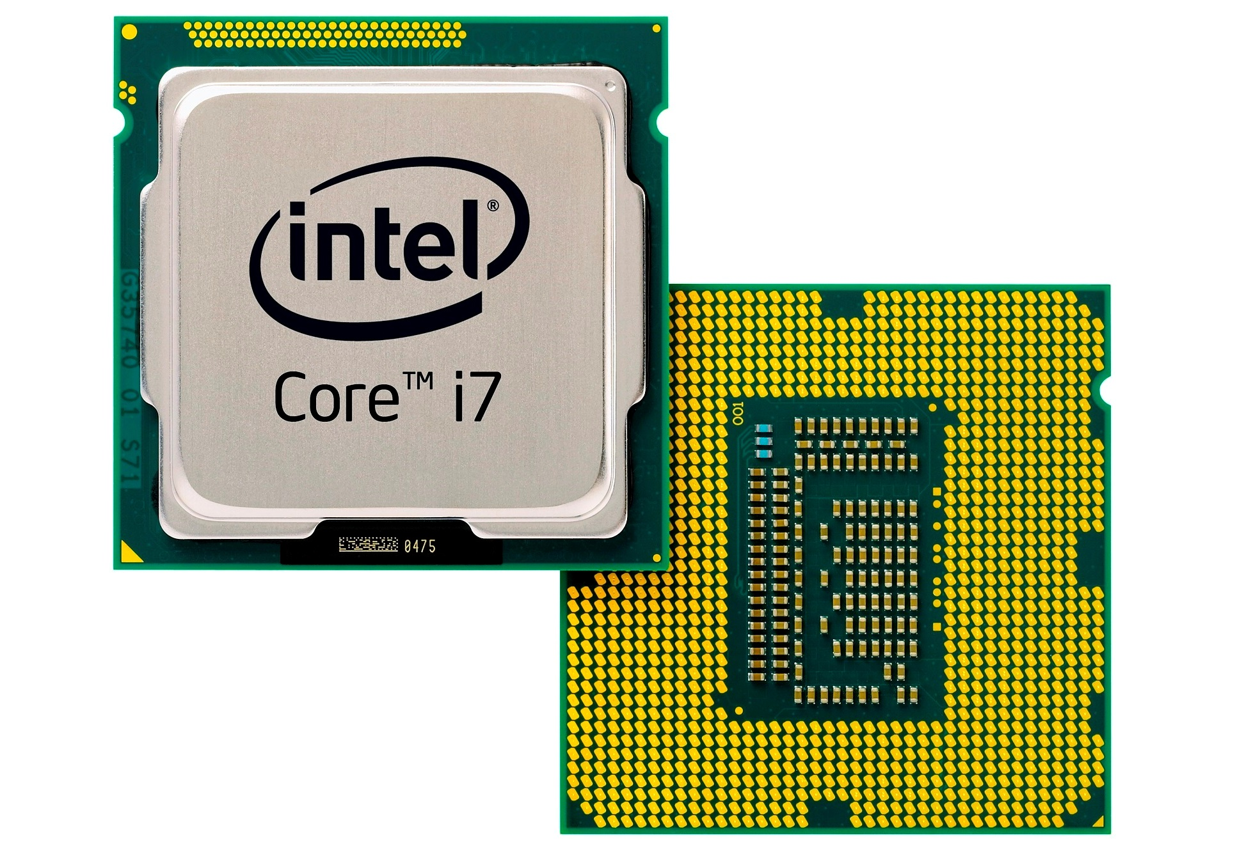
Fourth Generation (1971 – Present)
The development of the microprocessor brought about personal computers. Machines became affordable and widely used at home and in offices. Graphical user interfaces and the internet emerged. Notable systems include the Intel 4004 and Apple Macintosh.

Slide 8
Fifth Generation (Present and Future)
The fifth generation focuses on artificial intelligence, machine learning, and quantum computing. These systems aim to mimic human thinking and learn from data. Technologies like voice assistants, facial recognition, and AI bots represent this era. Examples include IBM Watson and Google AI.

Slide 9
Thank You

